Slide 1
HOW TO INSTALL TEXT EDITORS
Mandy Farrugia

Slide 2
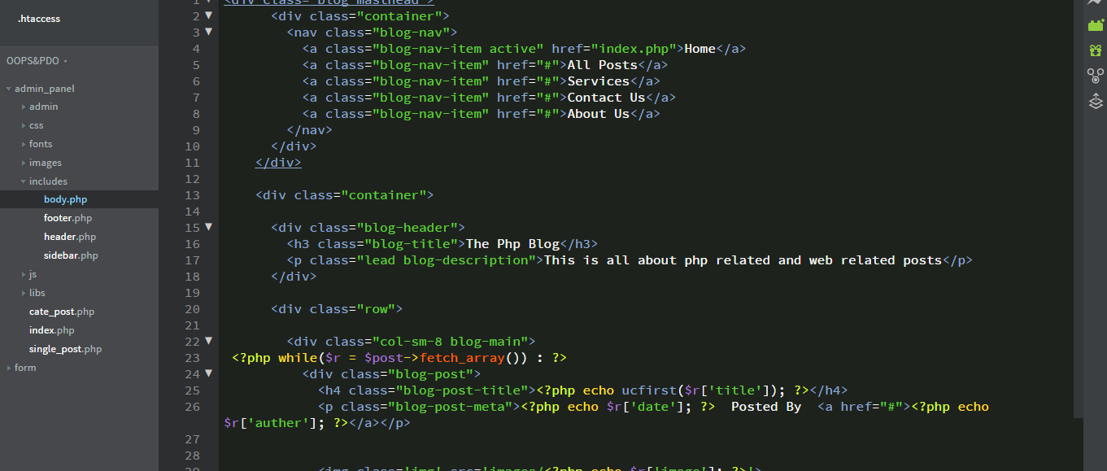
TEXT EDITORS
First of all, what is a text editor and what is the purpose of a text editor?
A text editor is simply a program enabling user to edit plain text, it is primarily used to edit source code. A text editor can be something as simple as Notepad to Visual Studio Code. The former is not user-friendly as there is no IntelliSense and auto-indentation.
Modern text editors typically come with features such as autosave, a download section for extensions/plugins, as well as IntelliSense and code formatting.

Slide 3
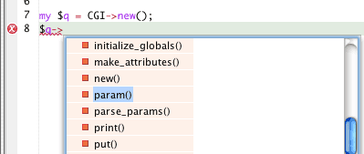
INTELLISENSE
What is IntelliSense and what does it do?
IntelliSense, otherwise known as automatic/intelligent code completion, speeds up the process of writing code by suggesting keywords (such as built-in methods, user-defined methods, variables, etc) to reduce typing errors and syntax errors. Such attempts are done via a pop-up box. Another advantage would be that you wouldn’t need to refer to external documentation as there would usually be a summary related to built-in functions/properties.

Slide 4

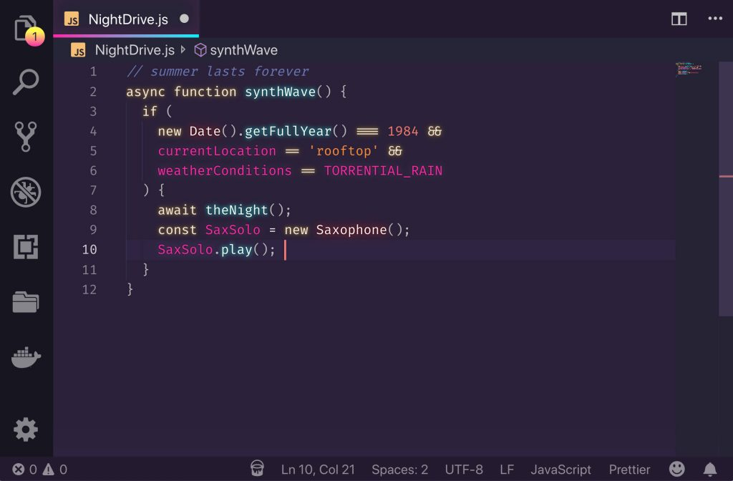
Visual Studio Code is a free-of-charge text/source code editor developed by Microsoft.
Visual Studio Code is compatible with Microsoft Windows, macOS and Linux.
Features include autosave, installation of extensions (we will be installing the Live Server extension), debugging tools, embedded Git, syntax highlighting, auto-save and automatic code completion.
Visual Studio Code was written in TypeScript, JavaScript, HTML and CSS.

Slide 5

VISUAL STUDIO IDE .vs VISUAL STUDIO CODE
Visual Studio is an IDE (Integrated Development Environment), whereas Visual Studio Code is a text/source-code editor. Visual Studio is resource-heavy and requires a large space to install, whereas Visual Studio Code only requires a minimum of 300MB of RAM to work properly.
The IntelliSense of Visual Studio Code is not as advanced as that of Visual Studio.
You will not be able to compile your code on Visual Studio Code. (unless the appropriate extensions are installed and the terminal is used)
The focal point of Visual Studio is the development of .NET/ C#/C++/F# projects along with database management via Microsoft SQL Server/MySQL. Whereas, the focal point of Visual Studio Code is supporting web-based technologies such as HTML, CSS and JavaScript.
Visual Studio comes in three editions; Community, Professional and Enterprise. Whereas Visual Studio Code comes in just a single free-of-charge version.

Slide 6
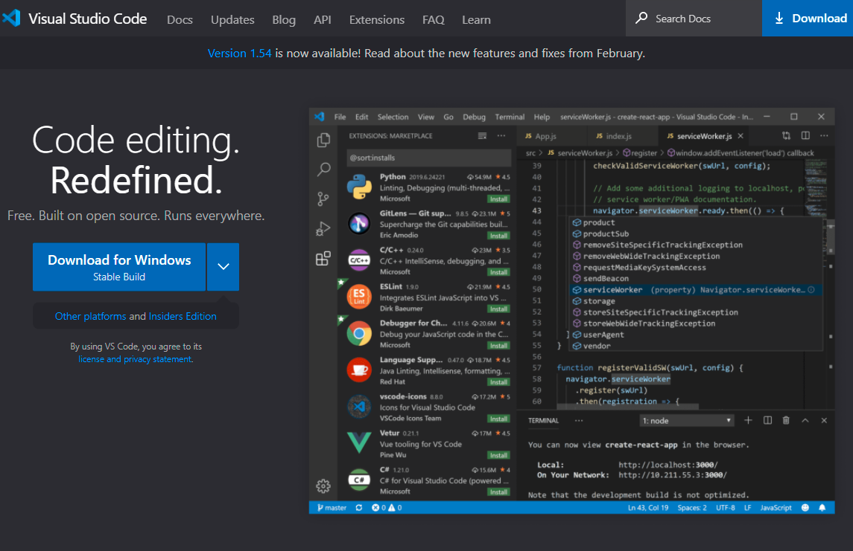
DOWNLOAD VISUAL STUDIO CODE
Search for Visual Studio Code. The first hit would be a link to the official website dedicated to Visual Studio Code.
The website will detect your operating system and suggests the appropriate version depending on your operating system as well as the architecture (32-bit or 64-bit)
You may download the stable build. The download process should start automatically. At the time of writing, the latest version of Visual Studio Code is 1.5.4 and the download size is 69.7MB (megabytes). Depending on your bandwidth, it should take up to a few seconds to a couple of minutes to finish downloading.

Slide 7
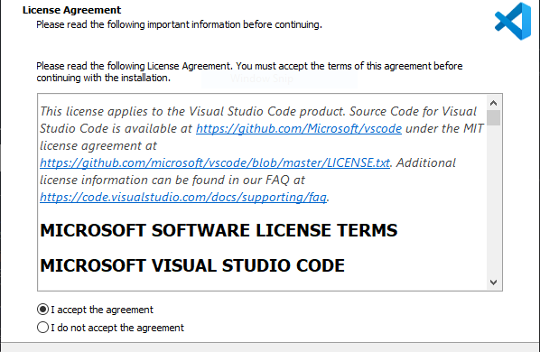
INSTALLING VISUAL STUDIO CODE
You are not required to read the license agreement. (Feel free to do so if you have time to spare, given most of us are sticking to lockdown)
In order to proceed, you will be requested to accept the license agreement. Once you have selected the ‘I accept the agreement’ radio component, press Next.

Slide 8
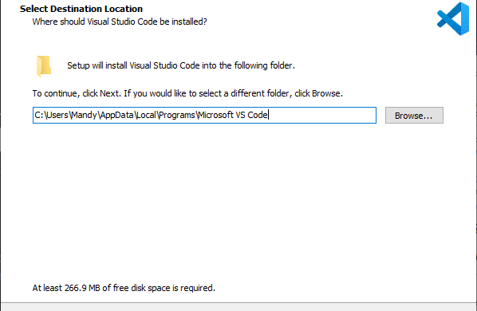
INSTALLING VISUAL STUDIO CODE
Ideally, you should leave the path settings intact unless you intend to install Visual Studio Code on a pen drive/external hard disk.
You will be advised that 267MB of free disk space is required.
Once you are satisfied with the path settings and the disk space cost, press Next.

Slide 9
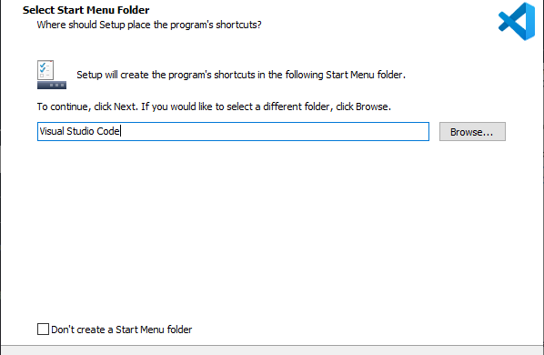
INSTALLING VISUAL STUDIO CODE
Ideally, you should leave the program shortcut settings. Moreover, you should also create a Start Menu folder to easily access the program.
Once you are satisfied with the program shortcut settings, press Next.

Slide 10
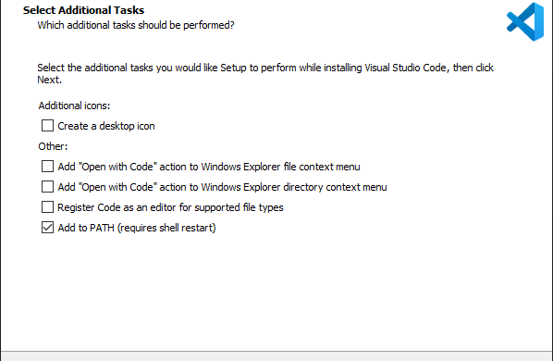
INSTALLING VISUAL STUDIO CODE
Although the first four options are optional, please leave the last option Add to PATH (requires shell restart) enabled.
Since there will be a directory dedicated to Visual Studio Code in the Start Menu, there is no need to create a desktop icon.

Slide 11
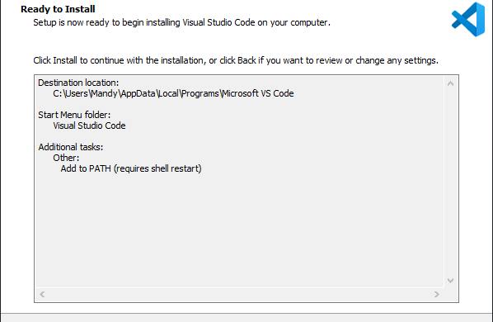
INSTALLING VISUAL STUDIO CODE
This is your last chance to review changes and go back to amend the installation settings.
If you are satisfied with the settings in the panel, select Install to commence the installation process.

Slide 12
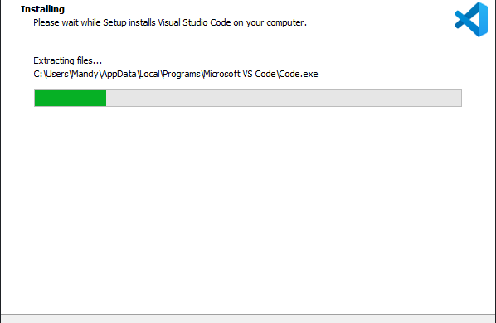
INSTALLING VISUAL STUDIO CODE
The installation process can take a few seconds to a couple of minutes depending on your computer specifications. If you are installing on an SSD (Solid State Drive), the installation will be ready within seconds.
Please do not interrupt the installation process, allow the process to take as long as necessary.
You will be notified when the installation is completed, you need not launch Visual Studio Code for the time-being. Select Finish. Within the Start Menu, you should see that a directory for Visual Studio Code has been included.

Slide 13
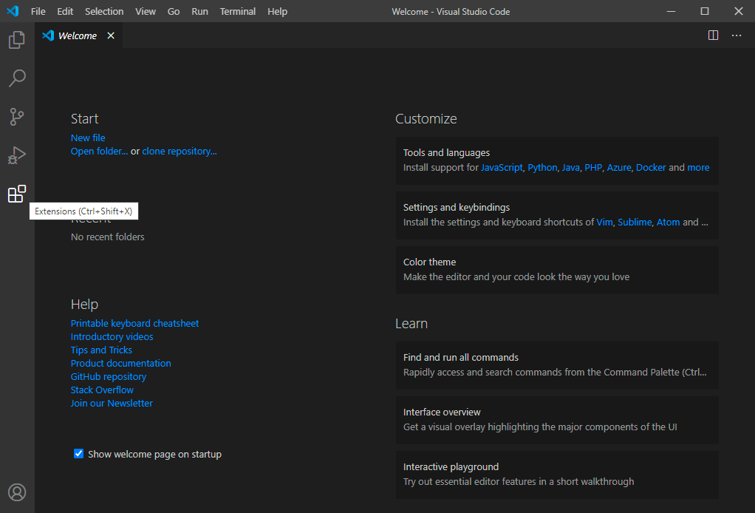
SETTING UP LIVE SERVER EXTENSION
You may disable the Show welcome page on startup checkbox. Doing so will not impact the behavior of Visual Studio Code in any way.
In order to install the Live Server extension, you would need to press the fifth and last button within the sidebar on the left or press the Ctrl+Shift+K key combination.

Slide 14
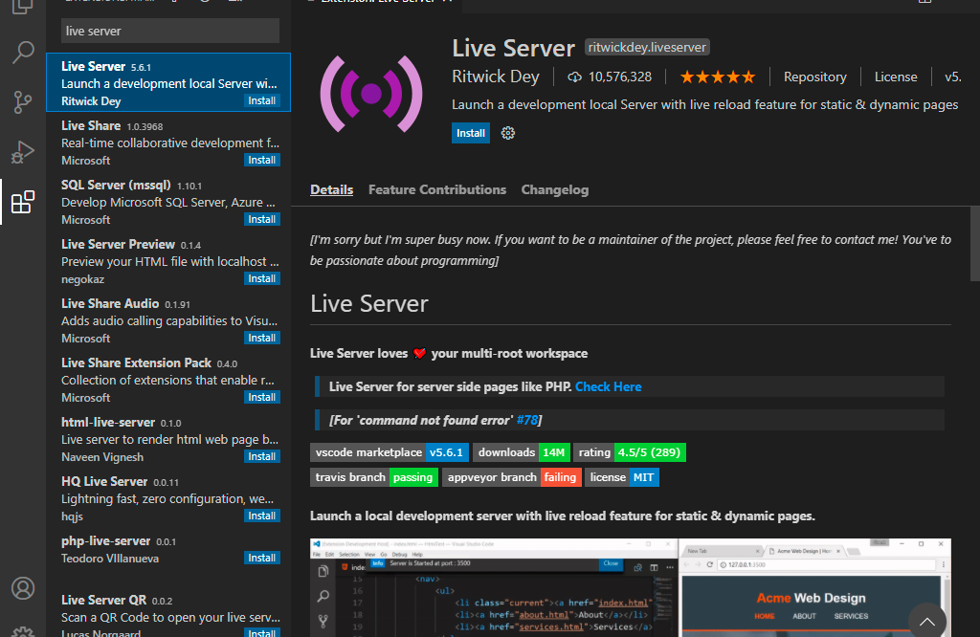
SETTING UP LIVE SERVER EXTENSION ON VISUAL STUDIO CODE
Search by Live Server via the Extensions Management search input field.
Select the first hit (Live Server by Ritwick Dey).
Install Live Server extension and wait for Visual Studio Code to install and configure Live Server.

Slide 15

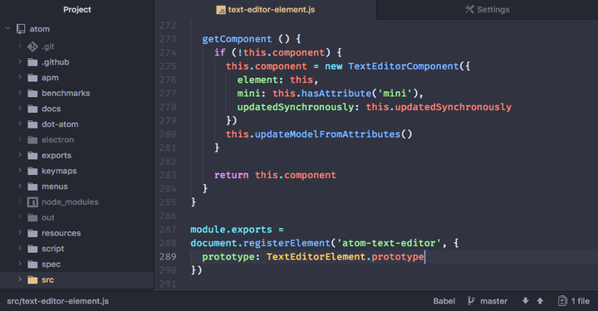
Atom was developed by GitHub, initially released on 26th February 2014. Atom is free-of-charge and is also open-source via GitHub.
Atom is compatible with Microsoft Windows (64-bit versions from Windows 7 onwards), macOS (as from 10.9) and Linux.
Atom was developed using HTML (for the user interface), CoffeeScript, JavaScript and Less. It is a desktop application built using web technologies.
Features include embedded Git, changing appearance theme, as well as installing third-party extensions/plugins typically written in JavaScript. Syntactic highlighting and auto-code completion functionalities are not built-in and are to be achieved via third-party plugins.

Slide 16
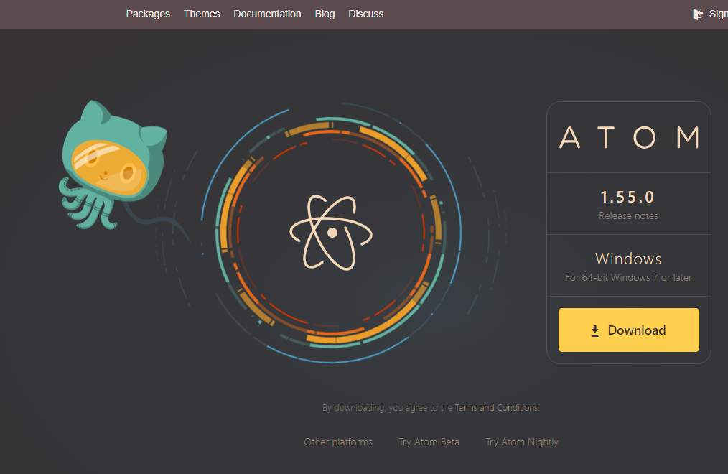
DOWNLOAD ATOM
Search for Atom. The first hit would be a link to the official website dedicated to Atom.
The website will detect your operating system and suggests the appropriate version depending on your operating system.
You may download Atom. The download process should start automatically. At the time of writing, the latest version of Atom is 1.55.0 and the download size is 182MB (megabytes). Depending on your bandwidth, it should take up to a few seconds to a couple of minutes to finish downloading.

Slide 17

INSTALLING ATOM
Atom installs from within the background. Please do not interrupt the unattended installation process. You need not agree to any license agreements, set installation paths and whatnot. By downloading Atom, it is assumed that you have agreed to the terms and conditions.

Slide 18
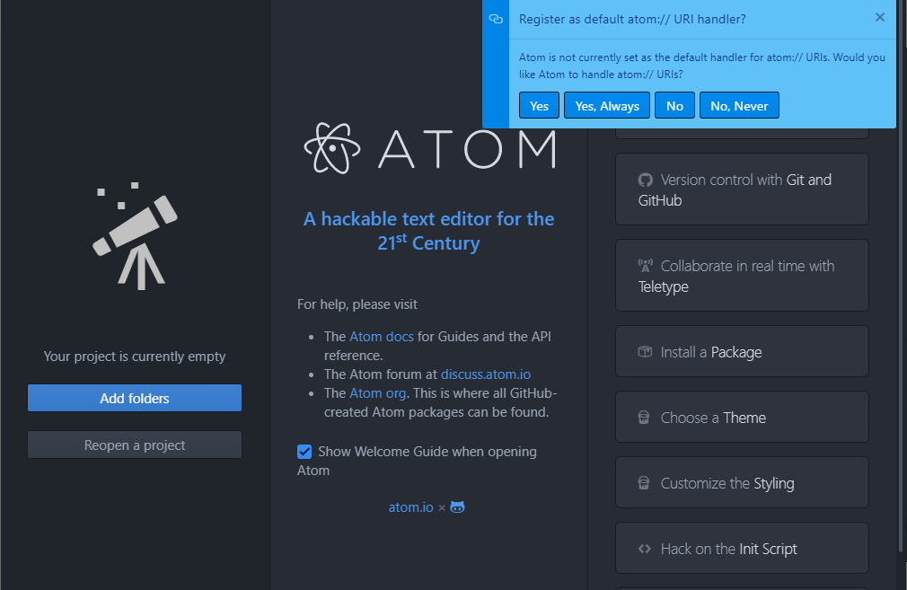
GETTING STARTED WITH ATOM
You need not register as default atom:// URI handler, thus press No/No, Never.
You may disable Show Welcome Guide when opening Atom checkbox. This will not affect the behavior of Atom.
The section on the far-right presents you with a plethora of options to get started with Atom, such as cloning a GitHub repository (embedded Git), changing appearance settings, installing third-party extensions.

Slide 19
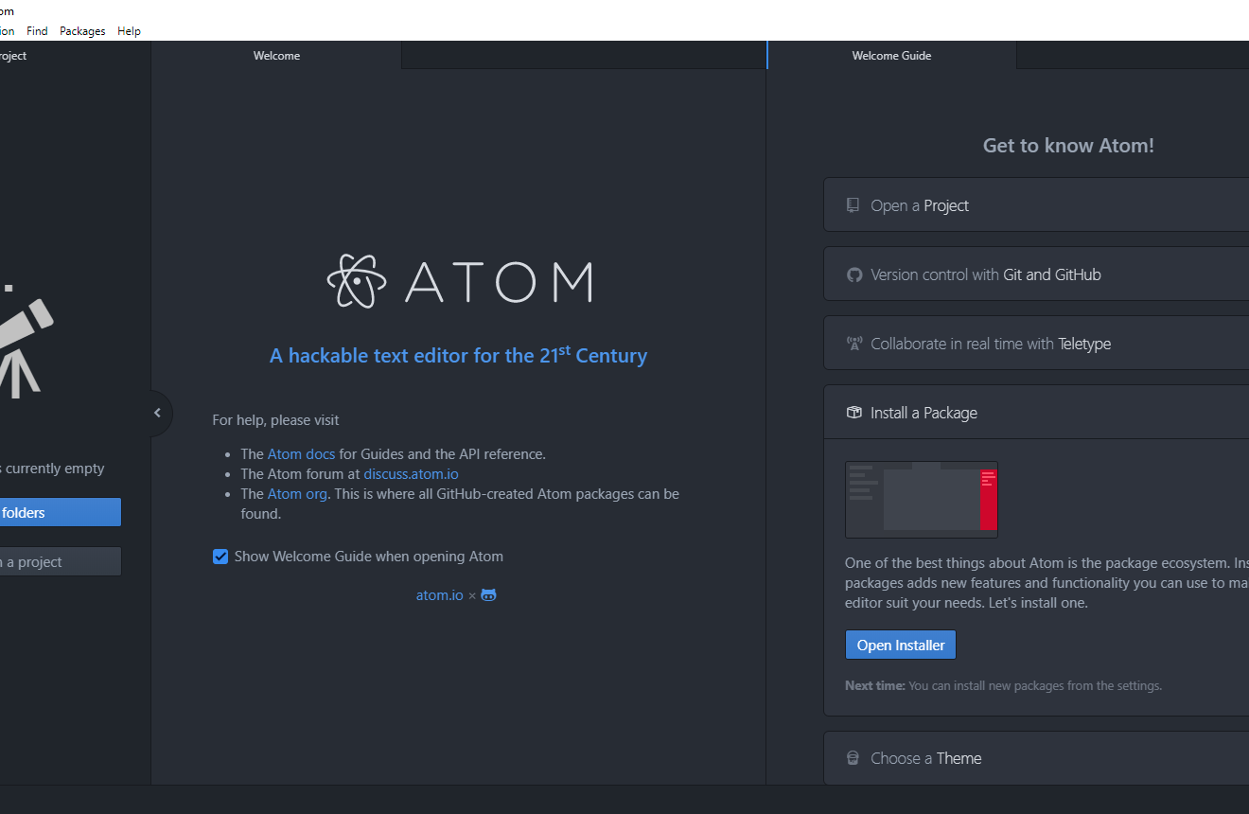
SETTING UP LIVE SERVER ON ATOM
Expand the Install a package accordion and press Open Installer.
Another tab named Settings will open within the second section next to the Welcome tab.

Slide 20
SETTING UP LIVE SERVER ON ATOM
Expand the Install a package accordion and press Open Installer.
Another tab named Settings will open within the second section next to the Welcome tab.

Slide 21
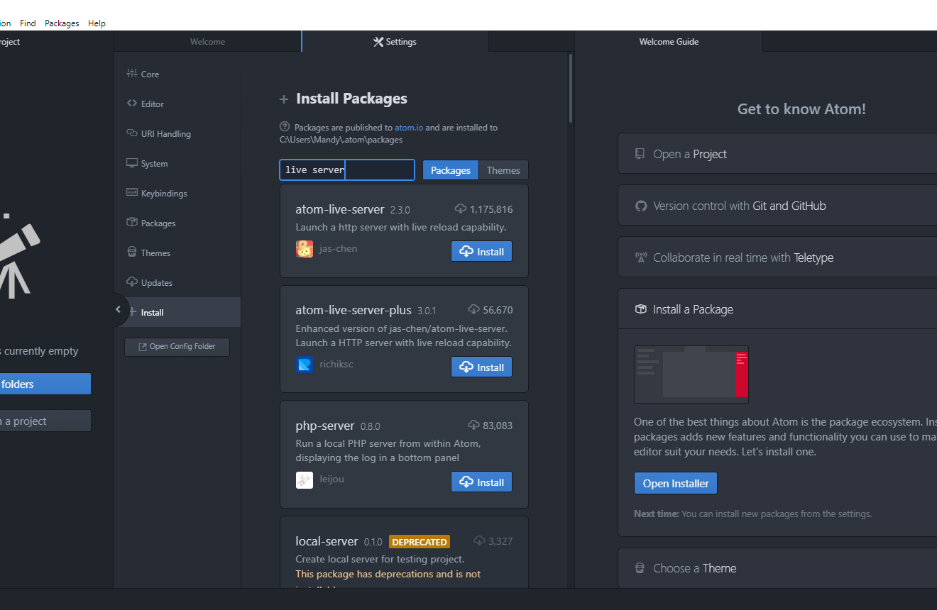
SETTING UP LIVE SERVER ON ATOM
Search by Live Server and press Enter.
Install atom-live-server by jas-chen.
Allow Atom to take as long as necessary to install the extension. Once installed successfully, the Install button will be replaced with two buttons; Uninstall and Disable.
Kindly refrain from installing deprecated packages as help and support would be minimal to none.

Slide 22
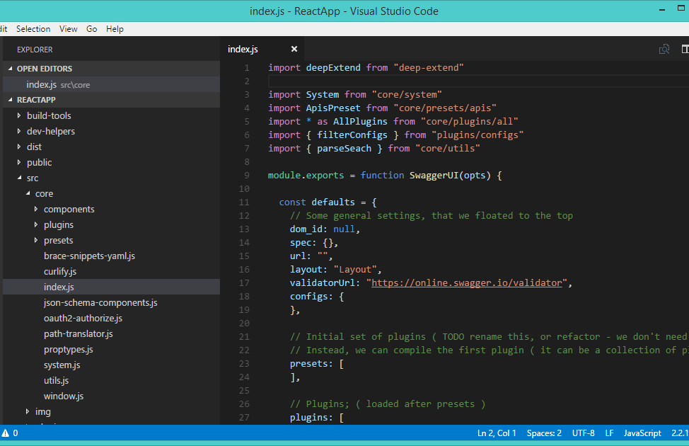
FINAL VERDICT
Which source/text editor should you use?
Visual Studio Code is the best way to go for beginners as there is little to no need for manual configuration. You need only set up Live Server. The rest such as auto-save, Emmet (speeds up HTML and CSS workflow), auto-code completion are built-in.
Although Atom is an excellent alternative to Visual Studio Code, it would be silly (if not, time-consuming and frustrating) to have to set up components manually via third-party extensions when they are built-in within Visual Studio Code.

Slide 23
Nota bene
Knowledge of configuring and using source code/text editors is not a prerequisite. The recording will demonstrate the installation and configurations of the text editors from start to finish. The presentation recommends the best two source code editors to date. There might be other text editors to be demonstrated during the live sessions although this cannot be guaranteed.
Please do not be discouraged by certain advanced features in source code editors.
You are by no means forced to stick to a specific source code editor. If you feel more comfortable with Atom (or any other source code editor for that matter…) rather than Visual Studio Code, then go ahead.
If you have any doubts, please send me a private message (via Microsoft Teams chat/channel or Messenger) or contact me via email. (In case you are unable to access your mail application, my email address is as follows: mandy.farrugia.c10352@mcast.edu.mt)
Alternatively, text editor binaries can be found within Files > Text Editors from the Client Side Scripting (2021) group via Microsoft Teams. There are sub-folders for each source code editor.
“Knowing is not enough, we must apply. Wishing is not enough, we must do.”
“We generate fears while we sit. We overcome them by action.”
“Failure is simply the opportunity to begin again, this time more intelligently.”
“Security is mostly a superstition. Life is either a daring adventure or nothing.”

Slide 24


Slide 25


